Slide 1
Schedular Program
Jacob Huerta, Ben Sprankle, Martin Aguilar
CompSci-2
04/19/2025

Slide 2
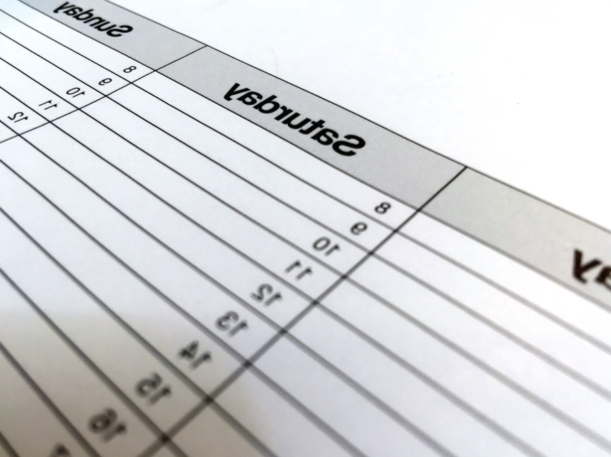
Hello world! We created this Schedular program In order to assist others in simplifying their day-to-day needs in a proper organized fashion for their day!

Slide 3

Implementation
This Scheduler class was created to help users organize tasks based on priorities and time allocation. It allows the user to input tasks, assign priorities, and specify how much time each task requires. The program then reorders the tasks based on their priority and incorporates blocked times for specific days.

Slide 4
Goals/demo
Time Management for busy professionals:
- This helps to streamline daily tasks and allocate time efficiently based on priority.
-Minimize idle hours and ensure productive use of available time.
Task Organization for Students:
-Schedule assignments, study sessions, and extracurricular activities.
- Track and prioritize deadlines to avoid last-minute stress.
Balancing Work and Personal Life

Slide 5
Future work/conclusion
Enhancements:
Expanding Functionality: Introduce features like recurring tasks dependencies between tasks, or automatic prioritization based on deadlines.
Adaptability:
Allow customization of scheduling algorithms to meet individual or organizational needs

